Slide 1
Local Care Partnerships
#MakingStuffBetter for people in Leeds

Slide 2
The NHS Long Term Plan
Improving population health
Improving care outside of hospitals (primary and community services)
‘fully integrated community-based health care’ to meet the needs of a changing population

Slide 3
‘shared responsibility for health’
Notes:
a ‘fundamental shift’ in the way that the NHS works alongside patients and individuals.

Slide 4
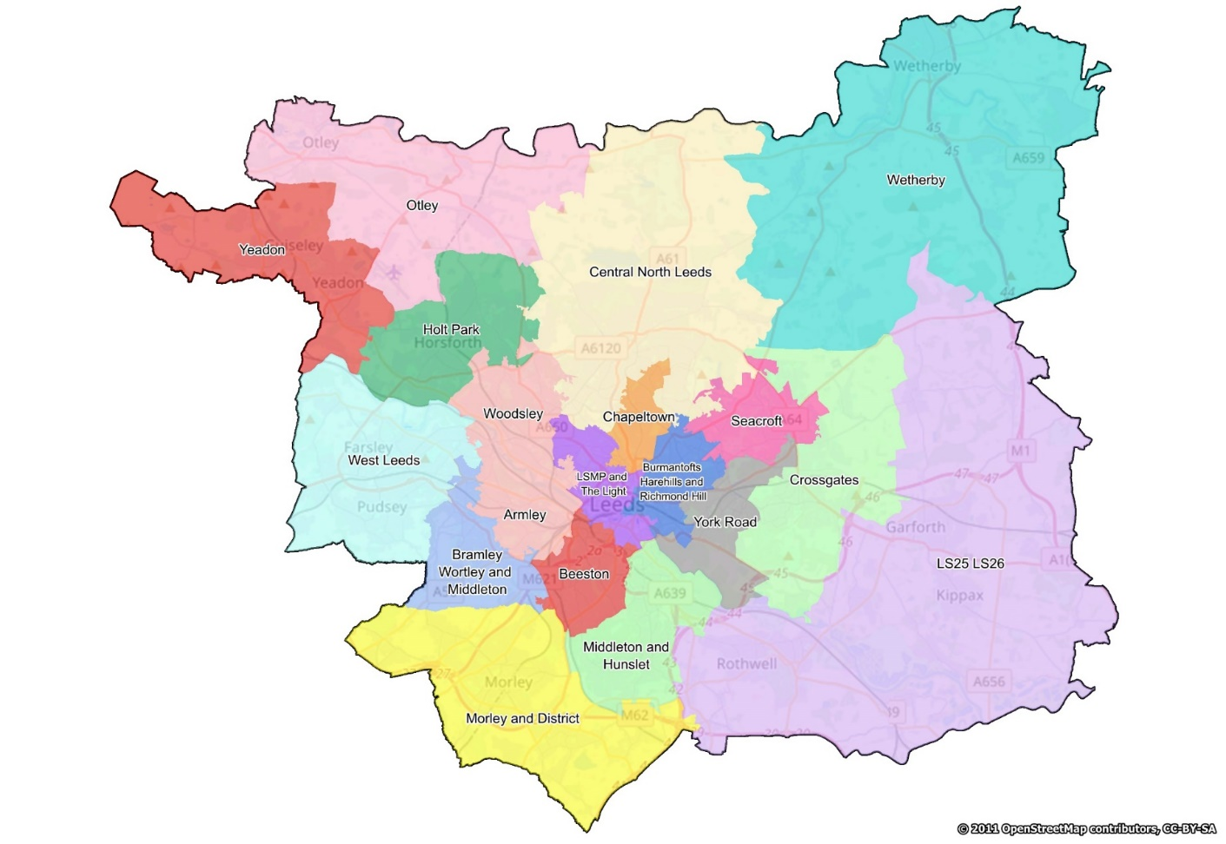
What are Local Care Partnerships?
The model of joined-up team working adopted in Leeds to improve health and care delivery to local people
Geography based
Networks of services that cover 30-75k population.
Joined up partnership working
Focus on the wider determinants of health at scale.
Address the shortfall of the traditional medical model for complex patients.

Slide 5
Where are the Local Care Partnerships?
Armley
Beeston & Middleton
Bramley, Wortley & Middleton
Central
Cross Gates
HATCH
Leeds Student Medical Practice & The Light
LS25/26
Morley
Otley & Aireborough
Seacroft
West Leeds
Wetherby
Woodsley & Holt Park
York Road
Notes:
Question: Looking at the MAP, what areas do you think are the best connect with your work?

Slide 6
Partners involved in an LCP may include: - Primary Care - Public Health - Social Care - Third sector - Social Prescribing - Healthwatch - Housing - Employment services + LCP development team

Slide 7
Place
Systems & Structures
ASSETS
Relationships
Place

Slide 8
What have the Local Care Partnerships done?
Supported the creation of ‘Multi-disciplinary Teams’ at a local level.
Funding bids
Shared roles
Learning workshops
Winter Planning workshops

Slide 9
What are the current LCP priorities?
Winter Planning – Working together to make sure all communities are supported during the winter season.
Population Health Management – Using NHS and Leeds City Council information on people and communities to identify local priorities.
Digital Inclusion – Working with services and communities to overcome barriers to digital tools and resources.
Systems – Improving mechanisms for enabling assets within communities to engage with the LCPs and work can be delivered in a joined up way.

Slide 10
Any questions?

