Slide 1
.
Third Sector Understanding and Engagement with Integrated Health and Care Systems in Leeds and WY&H

Slide 2
Context
A significant re-organisation of the health system
Moving extremely quickly and appears to be at a critical point.
Offers key opportunities and threats for the third sector.
Forum Central, as health and care infrastructure organisation is leading work to secure best outcome for the third sector.
Secured our place in the Integrated Care Partnership and recognition that diversity of individual organisations can sign up to the partnership through Forum Central.
Third sector representation and engagement at both Primary Care / Local Care Partnership level through Forum Central and at WY&H level through Harnessing the Power of Communities (HPoC)

Slide 3
Three Key elements:
1. West Yorkshire Integrated Care Partnership
- The West Yorkshire Integrated Care Partnership will be the body where strategic decision making about health service priorities (laid down by NHS England) is delivered.
- In order for the third sector to achieve maximum advantage from the new statutory duty to collaborate it is important that the third sector has a strong voice at this level
- Forum Central and the other West Yorkshire TS partners are represented

Slide 4
2.’Place-Based’ (Leeds) Integrated Care Partnership
Potential for increased partnership working and the devolved budget may lead to opportunities to codesign and coproduce as well as the potential for investment in health and care focused third sector organisations.
Securing an integral role for the third sector in decision making at this level
It is likely that they will be the representative body shaping services on behalf of health and care organisations in Leeds; hence securing the third sector’s role in the conversation about how services develop in the future.
Forum Central are is consulting with third sector organisations regarding the way their role in advocating for the health and care third sector at the Leeds Integrated Care Partnership should work.

Slide 5
3. Local Care Partnerships
Local Care Partnerships will continue to be a key way of delivering services at the neighbourhood level
It is expected that LCPs will seek to deliver services through the third sector, building existing work
Subsequently, sustaining a strong voice at local level will remain critical as the role of the LCPs develops
The important function of LCPs in delivering local health services and the role of third sector in them could be strengthened by building on LCP delivery

Slide 7
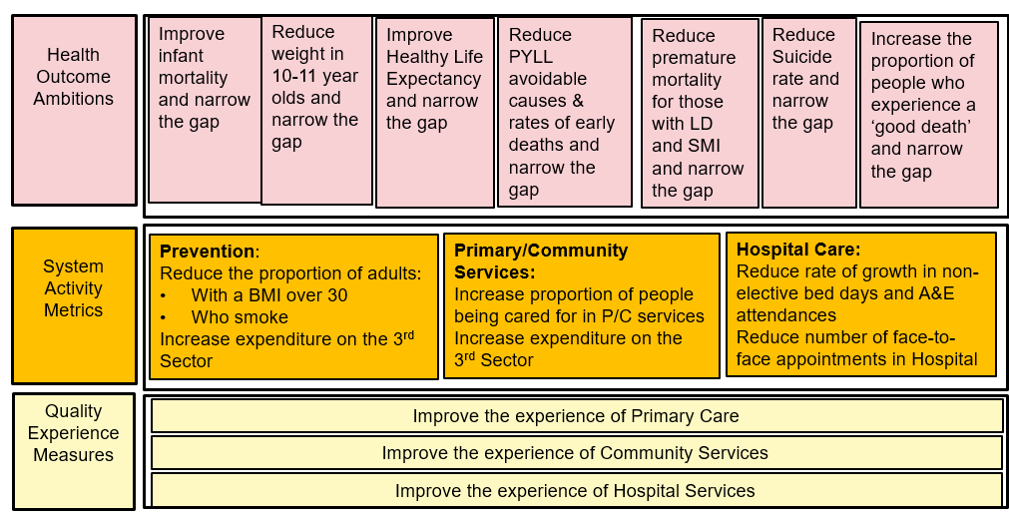
The Development and implementation of the Integrated Care Partnership
o An alliance of NHS, social care, third sector providers, NHS and local authority commissioners who work together to improve population health outcomes through collaboration not competition.
o The implementation of the ‘Left Shift Blueprint’. Via the ICP to deliver the following strategic indicators through a series of health & care programmes.

Slide 8
Key Driver: Leeds Left Shift
- Health Outcome Ambitions – These are longer term indicators that we are looking at over a 10 year period - Measurement of system activity –indicators will provide immediate view of impact and will be measured through the Leeds Data Model - Quality experience measures – This will be measured through the new style friends and family test and look at quality experience in primary care, community services and hospital services o That the third sector is a fundamental component at ICP and Programme level both is shaping this work, clinical leadership and delivery. o PCNs, as the core to LCPs will be the fundamental building block to achieving the strategic indicators o Removal of the NHS internal market meaning fewer contracts/ procurements and more collaborative approaches focussed on population health and delivery through pathways

Slide 9
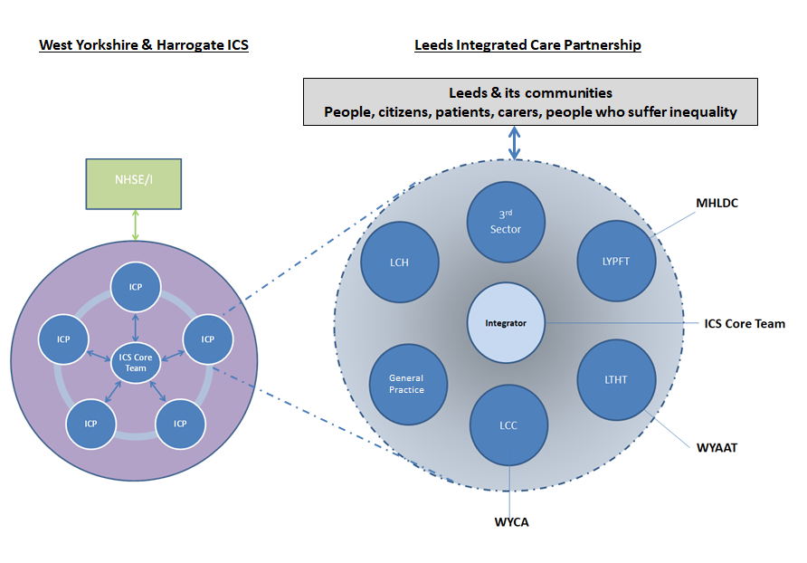
Proposed model for WYHICS -Leeds ICP

Slide 10
Principles
Person-voice at the heart of the design and deliver of accelerator
Striving to achieve 'Person-Centred Integrated Care' (National Voices)
Founded on a data-driven, clinically and professionally-led Population Health Management Approach
Enables priorities set out in Left Shift Blueprint
Underpinned by agile yet robust quality improvement methodology (any project should have an explicit and measurable aim, articulated theory of change etc).
Led through matrix teams of experts from across our place demonstrating distributive leadership and extreme teaming behaviours
Delivers demonstrable change by August 2021
Draws on local, national & international research, evidence and best-practice
Creates a sustainable method and community of practice that will underpin the way in which the ICP transforms care going forward
Supports and promotes sustainability

Slide 11
Recommended that Boards:
Recommendation 1 – Reaffirm support for our shared ambition as measured by the strategic indicators described within the city’s Left Shift Blueprint.
Recommendation 2 – Commit their organisations to a further degree of integration by tasking their leaders to scope, define and propose arrangements for a Leeds ICP.
Recommendation 3 – Provide support in principle to the creation of a partnership agreement and/or joint committee that has delegated powers to underpin and enable the Leeds ICP.
Recommendation 4 – Provide sign-up to securing a co-ordinating/integrating set of capabilities in the city through a dedicated ICP function and commitment to doing things once where it makes sense to do so.
Recommendation 5 – Sign-up to a specific relationship with the ICP, as a constituent part of the ICS, that takes responsibility for the discharge of duties in Leeds (as opposed to duties being discharged separately to the ICP).

