Slide 1
Mental Health Information & Strategy Meeting, 26th May, 1-3pm

Slide 2
Agenda
13:00 Sarah Wilson, Forum Central: Updates
13:10 Karl Witty, Forum Central: Local Care Partnerships
13:25 Liza Kellett, Trust Leeds: Self Reliant Groups (SRGs)
13:40 Member Updates & Introductions
14:10 Break
14:20 Breakout Room Discussion: New ways of working, mixing online & face to face provision
14:55 Thanks and Close

Slide 3
Forum Central & Strategic Updates

Slide 4
Community-based Adult Mental Health Support Review
NHS Leeds CCG and Leeds City Council want to work the people of Leeds to co-produce a new model for community based mental health support in Leeds.
Six Themes
Crisis and urgent care
Mental health supported accommodation
Employment support
Specialist community support
Service user involvement
Refugee and asylum seekers support
Coproduction phase: ways to input
Workshops for organisations
Focus groups for people
Full information on this work and booking links: tinyurl.com/MentalHealthReviews
Notes:
Firstly, the Community Based Adult Mental Health Support Review - NHS Leeds Clinical Commissioning Group (Or CCG) and Leeds City Council want to work with the people of Leeds to co-produce a new model for community based mental health support in Leeds, including new ways for these services to work together and identifying opportunities for us to make improvements to what is already being provided.
The introductory session was yesterday and the six themes are:
Crisis and urgent care support
Supported accommodation
Specialist community support
Employment support
Service user involvement
Support for refugees and asylum seekers
The first phase of the work involves 6 workshops for organisations and current providers of services, then six focus groups for people who use services, carers and family members. I’d recommend coming along to any relevant sessions, you’re welcome to pick and choose, and letting the people who use your services know about the focus groups as well - there’s also the potential for a member of staff to come into an existing group to speak to people if that would be preferred, particularly if there are barriers to taking part in wider group discussions, because they want to be as inclusive and outward looking as possible. Go to tinyurl.com/MentalHealthReviews and it will take you to the page which has the booking links.

Slide 5
Community Based Mental Health Review
Timeline
25th May-27th July 2021 | Involvement & Coproduction Phase Introductory workshop 6 workshops (one for each theme). 6 focus groups for experts by experience, including people who use services, carers and families (one for each theme).
August 2021 | Detailed analysis of all the information gathered in the workshops and focus groups.
10th September 2021 | September - Another feedback workshop - to say where they are with the analysis and proposed next steps for new contracts.
October 2021 - September 2022 | Any procurement activity that may be required, dependent on what comes from the review.
October 2022 - March 2023 | Mobilisation period (getting everything ready)
1st April 2023 | New contracts formally come into effect
(tinyurl.com/mentalhealthreviews)
Notes:
In terms of the schedule for the review as a whole, the 6 workshops and 6 focus groups on each theme are called the coproduction and involvement phase which will last until July, then in August they’ll be looking through all the findings from those sessions and analysing them.
Then on the 10th September there will be another workshop sharing that analysis and what the next steps are for the contracts.
Then over the following year, October 2021 to September 2022, they will do any procurement activity that may be required, and what that looks like will depend on what comes out of the review process, but it should be outlined in the session on the 10th September.
Then between October 2022 and March 2023 is the mobilisation period, so getting everything ready for the new contracts to formally start on the 1st April 2023.
So that’s all we know for now, but again please do let me know any questions you may have as and when.

Slide 6
Mental Health Collaborative
A group of commissioners, providers of Health & Social Care Services & People with lived experience of mental health issues.
Goal: to improve the mental health & wellbeing of people in Leeds through strengthening partnership working.
Initial focus: Priority 6, timely access to crisis support.
Notes:
The mental health collaborative is a group of commissioners, providers of mental health and social care services and people who have lived experience of mental health issues, whose goal is to improve the mental health and wellbeing of people in Leeds through strengthening partnership working, with our first focus being Priority 6 of the MH strategy, around timely access to crisis support.

Slide 7
Mental Health Collaborative
Progress
Forum Central Mental Health Access to Crisis Third Sector Wider Working Group
6 pages of ongoing issues
6 pages of recommendations for crisis services
Presentation at define stage
Mental Health Collaborative Group Meeting: Define Stage
Mental health journeys of people with lived experiences
Overview of crisis summit findings
Presentation around transition
Presentation around wider third sector services and carers
Setting outcomes and measures
Mental Health Collaborative Next Steps:
Discovery Stage 15th July
Dreaming Stage 19th July
Wider Reference Group next meeting - postponed
Notes:
In terms of updates, there’s the Mental Health Collaborative group of crisis services and commissioners, and our third sector wider working group specifically looking at the impact of access to crisis on the wider system:
Our wider working group of around 30 third sector organisations had our first meeting on the 20th April and the quality of the feedback and recommendations we got were just incredible, so thank you so much to everyone who gave their time. 6 pages of ongoing issues and 6 pages of recommendations came out of the discussions, so tonnes of insight around how the system is working at the moment and how it could be improved.
The mental health collaborative core group had its first full meeting which they called the “Define” stage - and as part of the meeting I did a presentation on the ongoing issues and how narrow criteria for crisis support is negatively impacting on the third sector and carers - the feedback was that it was a powerful presentation which again is down to your feedback and insights, and it has helped set the scene for the priorities going forward.
The next stages of the mental health collaborative are the discovery and dreaming stages in July - and as part of that i’ll be doing another presentation around all of the recommendations that the group came up with - progress in terms of the content is a little slower than I had anticipated, so it’s likely we will postpone the July date I had put in the diary for the reference group to meet next, as we got so much done in that meeting and I don't want to bring the group back together until we can further the conversation, so it’s likely the next meeting will be late July or early September. I’ll get something in the diary soon and let everyone know.

Slide 8
Community Mental Health Transformation Plan
A plan to improve care for people with Severe Mental Illness (SMI). Specifically for adults & older adults:
With eating disorders.
With complex mental health difficulties associated with a diagnosis of a personality disorder.
In need of mental health rehabilitation services.
Broad overview of plan:
Integrated Community Mental Health Hubs which act as a single point of access to wider services and are co-produced by people with Severe Mental Illness.
Emphasis on the stepping up and stepping down support, avoiding the ‘cliff edge’ of support after being discharged.
‘No wrong door/shared front door’ approach, building a trauma informed culture of support, so that we reach those hardest to reach with SMI.
Notes:
Next, the Community Mental Health Transformation Plan
So this is the plan to improve care for people with Severe Mental Illness (SMI). Specifically for adults & older adults:
With eating disorders.
complex mental health difficulties associated with a diagnosis of a personality disorder.
And those in need of mental health rehabilitation services.
Just to recap a broad overview of the plan for those of you who are new to these meetings:
The idea is to create Integrated Community Mental Health Hubs which act as a single point of access to wider services and are co-produced by people with Severe Mental Illness.
There will be an emphasis on the stepping up and stepping down support, avoiding the ‘cliff edge’ of support after being discharged.
So a ‘No wrong door or shared front door’ approach, that is trauma informed
And there are three early implementer sites: Leeds Student Medical Practice and the Light, West Leeds and HATCH (Which covers, Chapeltown, Burmantofts, Harehills & Richmond Hill) and the work will spread over a minimum of three years.
In exciting news, they have just recruited a Programme Manager for Community Mental Health Transformation, Liz Hindmarsh, to lead on this work *input from Liz*

Slide 9
Synergi Creative Spaces Event
Notes:
So, some more events and meetings that are coming up. Firstly, you’re all invited to attend a Synergi Creative Spaces Leeds event: called Transforming Ethnic Inequalities in mental health: the journey so far, on the 8th June, 11am-1pm.
Creative Spaces: is a co-designed, solution-focused dialogue around supporting health systems to prevent or reduce ethnic inequalities and the multiple disadvantages experienced by people with severe mental illnesses.
It’s part of the work from the Synergi Collaborative Centre who do really innovative work - and Inspire North, Forum Central, Leeds City Council & Leeds & York Partnership Foundation Trust (or LYPFT) are all involved. There are two funded posts within the Synergi work, Delvina Saunders, who is focusing on adults and is based in Leeds City Council, and Marvina Newton who is focused on Children & Young People and is based in Forum Central. I’d highly recommend coming along to this event as it will give you a really good overview of all the work that’s been done so far in Leeds and the local priorities going forward.

Slide 10
This is Me Yorkshire - 9th June
tinyurl.com/thisismenorth
Notes:
The This is Me Yorkshire event on the 9th June, which is an anti-stigma event aiming to change attitudes towards mental health in the workplace through storytelling. It’s a national initiative that came from the Lord Mayor’s Appeal in London, and they’re having their first This is Me North event on the 9th June. For more info you can visit tinyurl.com/thisisnorth.

Slide 11
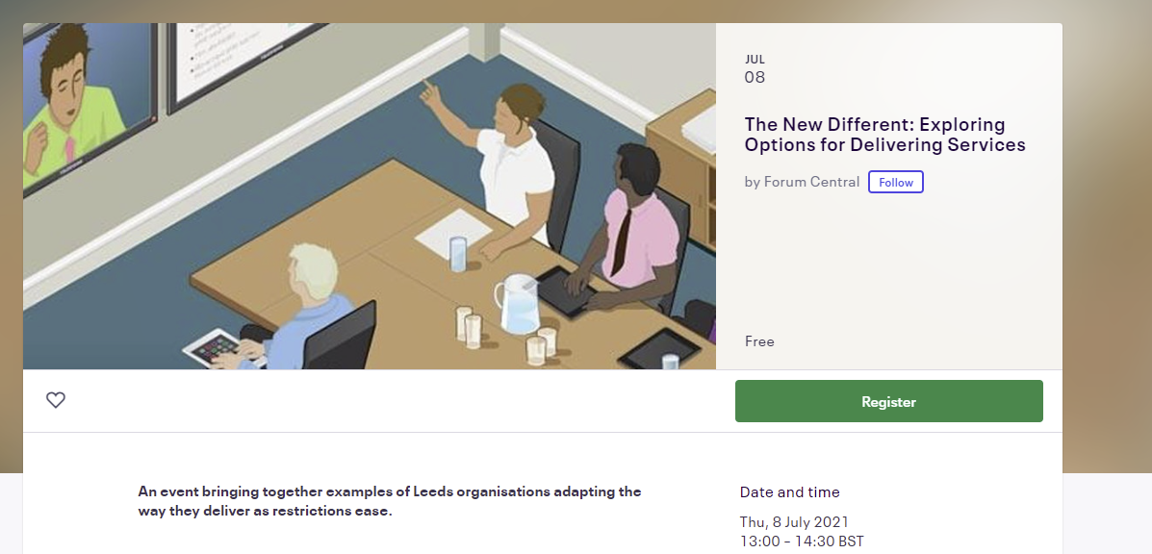
The New Different - 8th July
tinyurl.com/thenewdifferent
Notes:
As part of coproduction week, Forum Central are running an event called ‘The New Different: Exploring Options for Delivering Services’
I’ve been hosting discussions across the system in preparation for this event, including the one we’re going to have later on in this session, to find out more about new models of working as restrictions ease particularly hybrid or blended models, where people can take part either online or face to face, what people are planning to do, what the challenges are and exploring how to coproduce any changes with the people who use your services. Then as part of coproduction week on the second week of July we’re bringing together as much of the learning as we can into this event, with a series of case studies, so you can see how others are adapting to new ways of working and maybe get ideas you might like to bring to your organisation. Tickets are free for the zoom event, type in tinyurl.com/thenewdifferent to book your place.

Slide 12
Third Sector & LYPFT (Leeds & York Partnership Foundation Trust) Partnership Forum
Meetings were put on hold due to pandemic
Save the date: 1st July 9-11am
Theme: Reset & Recovery
Looking for examples of how the third sector has approached reset and recovery.
Notes:
Thirdly, the Third Sector and Leeds and York Partnership Foundation Trust (LYPFT) Partnership Forum met quarterly until December 2020, when meetings were put on hold due to the pressures of the pandemic, but we’re reinstating the meetings, and ask you to save the following date: Thursday 1st July 9am-11am. The theme is reset and recovery of services after COVID, so slight overlap with the new different event in terms of resetting services and any changes people are thinking about making, but broader than digital and hybrid models, with more of a focus on how LYPFT and the third sector can work together - they’re looking for some examples from the third sector, so if you’d be interested in being part of this let me know.

Slide 13
Leeds Integrated Care Partnership Development Programme: Third Sector Meetings
From April 2022, Integrated Care Systems (ICS) will become statutory organisations, absorbing commissioning functions currently done by Clinical Commissioning Groups (CCGs) and NHS England.
The Integrated Care Systems will devolve decision making and funding locally, through Integrated Care Partnerships (ICPs).
Email hello@forumcentral.org.uk for details.
Notes:
And lastly, you may have already heard that from April 2022, the way that commissioning works is changing nationally, so the Clinical Commissioning Groups (or CCGs) are being absorbed into new kinds of partnerships called Integrated Care Systems (or ICS’s) which are becoming statutory organisations (ours being the West Yorkshire & Harrogate ICS), and these systems will devolve some decision making and funding decisions locally into Integrated Care Partnerships or ICPs which will contain organisations from across sectors. That’s a very brief overview of what are complicated reforms, but Forum Central are running third sector meetings ensuring that the third sector are part of developing how this will work in practice as how the system will work is still very much in development, everyone is welcome to join these sessions if you’d like to hear more and be kept in the loop, please email hello@forumcentral.org.uk for more details.

Slide 14
Any Questions

Slide 15
Karl Witty
Third Sector Health & Care Development Officer
Local Care Partnerships

Slide 16
Local Care Partnerships
#MakingStuffBetter for people in Leeds

Slide 17
What is a Local Care Partnership?
A way of working that brings together, knowledge, skills and support
within local areas of Leeds.
Doctors in local surgeries
People working for the NHS Trusts
Leeds City Council (Adult Social Care, Public Health etc.)
Healthwatch
Local Councillors
Third Sector Organisations (including social prescribing coordinators)
Local Care Partnerships aim to make things better for people in Leeds.

Slide 18
Place
ASSETS
Systems & Structures
Relationships
Place

Slide 19
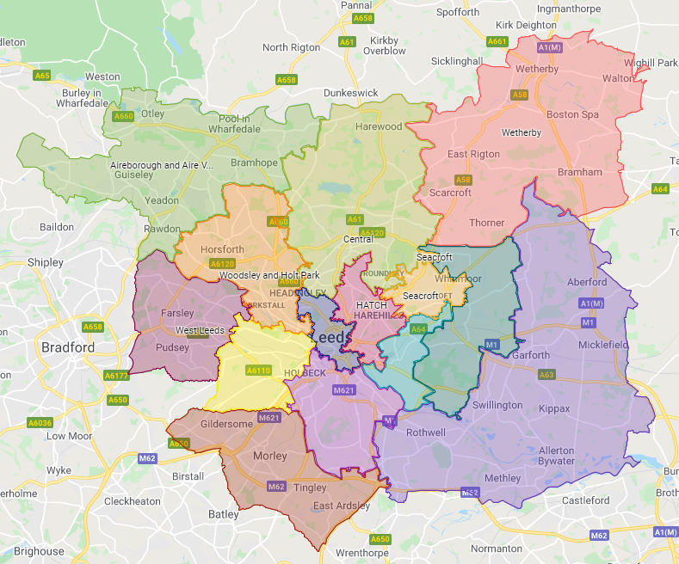
Where are the Local Care Partnerships?
Armley
Beeston & Middleton
Bramley, Wortley, Middleton
Central
Cross Gates
HATCH
Leeds Student Medical Practice & The Light
LS25/26
Morley
Otley & Aireborough
Seacroft
West Leeds
Wetherby
Woodsley & Holt Park
York Road
Notes:
Geography based
Focused around the needs of local people
Networks of services that cover 30-75k population.

Slide 20
The NHS Long Term Plan
Improving population health
Improving care outside of hospitals (primary and community services)
‘fully integrated community-based healthcare’ to meet the needs of a changing population

Slide 21
Notes:
The Leeds Health And Care System is complex

Slide 22
LCP Governance
Health & Wellbeing Board
Partnership Executive Group (PEG)
Local Care Partnership Programme Board
LCP
LCP
LCP

Slide 23
What have the LCPs achieved so far?
Brought different parts of the system together
Relationship building and peer support
Shared roles – Care Coordinators in HATCH, Seacroft and LS25/26
Joint Bidding – including successful bids lead by Third Sector Partners
Delivery of the Population Health Management Programme
Delivery workshops (e.g. winter planning, covid inequalities)

Slide 24
What are the current LCP priorities?
Relationship Building
Sharing understanding of who we are and what we bring to the LCPs
Working out how we work best together
Mental Health
Mental Health has been set as cross-cutting theme throughout all LCP work, but several LCPs have identified mental health as a priority workstream.
Community Mental Health Transformation early implementer sites (Leeds Student Medical Practice and The Light LCP, West Leeds LCP and HATCH LCP)
Population Health Management – Using system data to identify local priorities and inform interventions.
Ageing well
Frailty
Notes:
(Beeston & Middleton, Seacroft, West Leeds, Armley)

Slide 25
The Future of the LCPs?
LCPs a key part of the operating model for Leeds Integrated Care Partnership (ICP)
Two-year funding for LCP facilitation
Resources devolved to LCPs
Local Care Partnerships as early implementer sites for CMH transformation
Notes:
Funding for the LCP Development Team has been extended for two years and includes our Third Sector LCP role which will be added to the Forum Central contract.
Health Inequalities money to deliver work within LCPs
Each LCP has it's own 'personality'
Some LCPs have been focused around a specific population (PHM frailty focused) whilst others are progressing a broad range of shared priorities
Understanding is limited to a relatively small proportion of the workforce within the LCP
Governance structures vary widely
No LCPs are set up for shared decision making and budget management

Slide 26
What Next?
Check out the LCP website
Work out which LCP(s) fit best with you and your organisation
Get in touch

Slide 27
Liza Kellett
Trust Leeds: Self Reliant Groups (SRGs)

Slide 28
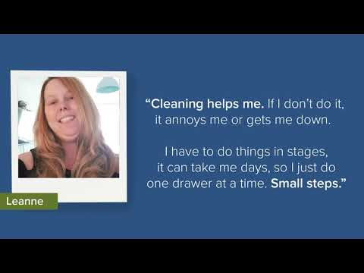

Slide 29
Member Updates
News
Upcoming projects
Anything you’d like to share!

Slide 30
Break

Slide 31
Roadmap Breakout Room Discussion
Tell us about the different ways you connected with people online during the pandemic.
Has anyone done hybrid/blended working so far? (eg a fitness class where the instructor is on a screen with participants all in one room, or a meeting where some people are on zoom and some are in person), or heard of organisations who are doing this?
Would organisations like to connect in this way? What do you think it might look like?
How can we make sure that any changes made meet the needs of the people we are working with? How can we involve them in this process?

Slide 32
Thank you for coming!

