Slide 1
An independent, expert report
The structure,
dynamics and impact
of the voluntary,
community and social
enterprise sector
A study of West Yorkshire Combined Authority
West Yorkshire and Harrogate Health and Care Partnership, and Humber, Coast and Vale Health and Care Partnership areas
Tony Chapman Professor of Policy and Practice
St Chad’s College Durham University
September 2021

Slide 2
Based on most credible, available data
Data drawn from
Third Sector Trends Survey
Establishing a definitive evidence base for the sector
https://www.communityfoundation.org.uk/knowledge-and- leadership/third-sector-trends-research/
Commissioning partnership
for this
analysis

Slide 3
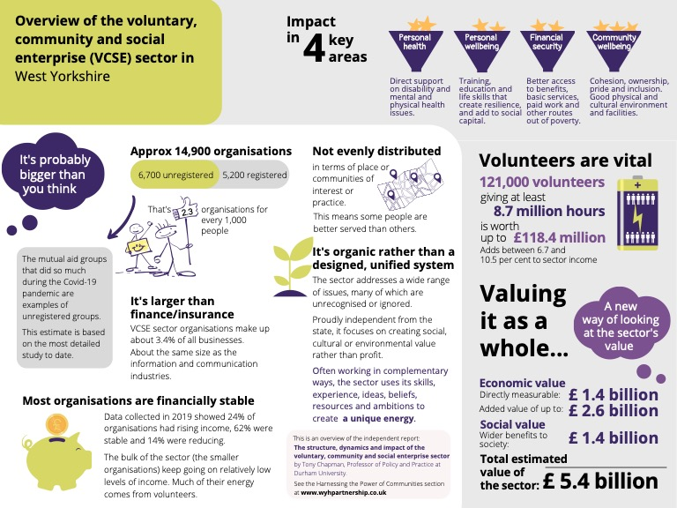

Slide 4
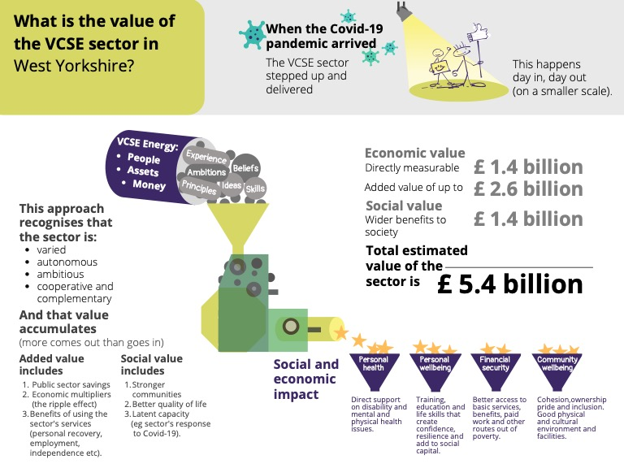

Slide 8
