Slide 1
Improving Population Health Fellowships 2025
Information pack

Slide 2
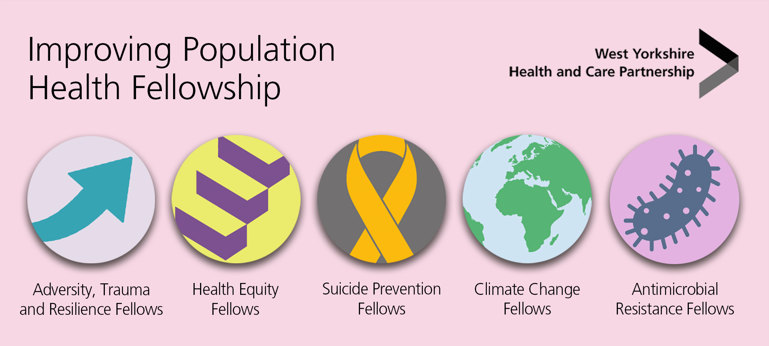
Background
We are very pleased to be entering the third year of our Improving Population Health Fellowship Programme. In 2022, The Partnership’s first Health Equity Fellowship was launched as part of the West Yorkshire Health and Care Partnership Health Inequalities Academy. We appointed 33 fellows who carried out projects to support our work to tackle health inequalities and make West Yorkshire an equity-informed system. Those projects make a real change.
In 2023 our fellowship grew, taking on more fellows and covering new areas from within our Improving Population Health Programme. In our third year, 2024 we were excited to announce the addition of Antimicrobial Resistance to our fellowship.
We are expanding the fellowship to cover other areas of the Improving Population Health Programme:
Health Equity (Year 4)
Adversity Trauma and Resilience (Year 3)
Suicide Prevention (Year 3)
Climate Change (Year 3)
Antimicrobial Resistance (AMR) (Year 2)
The following information pack will provide organisations, employers and our workforce with information about the:
Fellowship Programmes
Benefits of being a fellow
Benefits of organisations releasing people for the fellowship
How to apply
FAQs and more

Slide 3
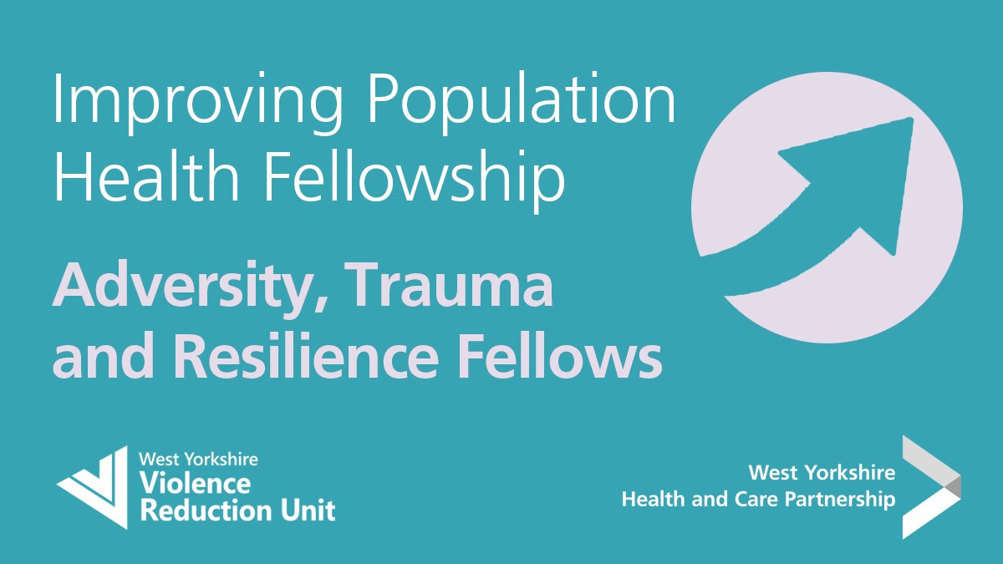
Improving Population Health Fellowships 2025
We are looking to recruit:
30 Healthy Equity Fellows
30 Adversity, Trauma and Resilience Fellows
5 Suicide Prevention Fellows
5 Climate Change Fellows
5 Antimicrobial Resistance (AMR) Fellows
...to our Improving Population Health Fellowships 2025

Slide 4
Timeline
Event | Date
Information pack available | 30 October 2024
Applications open | 13 November 2024
Event: first virtual information event | November 2024 – date TBC
Event: second virtual information event | December 2024 – date TBC
Applications close | 24 January 2025
Recruitment Panel | 27-29 January 2025
Notify applicants of outcome | 31 January 2025
Fellowship start date | 1st April 2025

Slide 5
Fellowship expectations:
The Improving Population Health Fellowships will run between 1 April 2025 and 31 March 2026.
Fellows will be expected to dedicate one day a week of their time to attend training and work on a fellowship project
Projects will be bespoke to the Fellowship themes, criteria and a list of potential projects will be provided
Projects could be delivered in the applicant’s usual place of work or contribute to wider joined up or system approaches taking place across the area. Submission of an interim and final report is required as part of the programme
Meetings and trainings may be face to face at a central location or virtually over MS Teams. Fellows are expected to attend all meetings and trainings and therefore fellows must be able to travel to meetings and will also require a device and an internet connection.

Slide 6
Benefits for organisations…
Fellowships will:
Provide the opportunity to change behaviour, empower employees, and build authentic relationships with networks and partners across West Yorkshire
Support professional and personal development, with no cost to the fellows organisation/employer
Meet the shifting needs of employees , organisations and communities/populations they serve
Give employees the confidence, insights, and motivation to expand or extend their work
Fellows will:
Gain valuable exposure and experience while learning under the guidance of mentors and experts
Receive guidance, institutional support, and professional development to the fellow
Gain practical knowledge through experiential learning
Be a champion within the organisation to support development in their chosen speciality
Fellows will bring back to the organisations:
New ideas, tactics, and perspectives
Taking part in social responsibility and community engagement
Contribution to the future success of the organisation in a given field

Slide 7
Benefits of being a fellow…
Enhance knowledge, skills, and capability by delivering a fellowship project in your chosen specialism
Mentor support throughout your fellowship journey e.g., embedding learning and developing relationships across West Yorkshire
Free Foundation Programme in Public Health training delivered by Health Education England and University of Leeds
Bespoke training in your chosen area with access to materials and educational opportunities
Expand your professional networks through engagement with other fellows
Access to the Improving Population Health Programmes of work in West Yorkshire e.g., Health Inequalities Academy and Network, Adversity Trauma and Resilience (ATR) Programme, Suicide Prevention Programme, Climate Change Programme, Prevention Programme and Antimicrobial Resistance (AMR) Programme.
Build relationships with our five places (Bradford District and Craven, Calderdale, Kirklees, Leeds and Wakefield)
Exposure to experts, programmes and organisations pioneering positive change
Publication of fellowship projects on our website and partner websites

Slide 8
Health Equity Fellows 2025
Programme objectives
Identify and respond to health inequity and inequalities Build equity and inequalities champions across West Yorkshire Create a health equity fellow peer Network Share learning and best practice across WY
Health Equity Fellows are part of the West Yorkshire Health and Care Partnership Health Inequalities Academy, working towards the ambition to equip all staff with an understanding of the individual and collective action we can take to create a more equitable health and care system.
We have set strategic ambitions to reduce health inequalities. The need for these ambitions has been reinforced by health inequalities made worse by the COVID-19 pandemic and the recent cost of living challenges faced by our population.
Addressing health inequalities requires a whole system approach from strategic planning and leadership to community level service delivery. This fellowship programme seeks to develop colleagues across West Yorkshire who understand the foundations of health inequity and have the knowledge, skills, and courage to build more equitable organisations and communities.

Slide 9
Health Equity Fellows 2025
To apply you must:
Be passionate about health equity
Seek the knowledge, skills, and courage to create more equitable organisations and communities
Want to become health equity champions and work with others to achieve change
Be committed to the delivery of a Health Equity Fellow project

Slide 10
Adversity, Trauma and Resilience (ATR) Fellows 2025
Programme objectives
Identify and respond to adversity, trauma and resilience Build trauma informed champions across West Yorkshire Create an Adversity, Trauma and Resilience Fellow Peer Network Share learning and best practice across West Yorkshire
Adversity, Trauma and Resilience Fellows will support our ambition of being trauma informed and responsive by 2030. This includes supporting all staff to gain and develop an understanding of the individual and collective action we can take to create a more trauma informed system.
Addressing adversity, trauma and resilience requires a whole system approach from strategic planning and leadership to community level service delivery. This part of the fellowship programme seeks to develop colleagues across West Yorkshire who understand the foundations of adversity, trauma and resilience and have the knowledge, skills, and courage to build more trauma informed organisations and communities.
Adversity, Trauma and Resilience Fellows will help to bring together the diverse organisations and professionals that influence trauma informed organisations.
To find out more about our work to date please visit the West Yorkshire Knowledge Exchange

Slide 11
ATR Fellows 2025
All projects and work under the ATR fellows need to embed the following principles of being trauma informed
Safety
Peer support and mutual self-help
Collaboration and mutuality
Empowerment voice and choice
Cultural, historical and gender issues
Cultural physical, relational and emotional. When safety and trust increase, threat, fear and danger decrease.
Organisational operations and decisions are conducted with transparency and the goal of building and maintaining trust amongst staff, clients, and family members of those receiving services.
These are integral to the organisational and service delivery approach and are understood as a key vehicle for building trust, establishing safety, and empowerment.
There is recognition that healing happens in relationships in the meaningful sharing of power and decision-making.
Organisation aims to strengthen the staff, client, and family members' experience of choice and recognises that every persons' experience is unique and requires and individualised approach.
The organisation actively moves past cultural stereotypes and biases, offers culturally responsive services, leverages the healing value of traditional cultural connections, and recognises and addresses historical trauma.
Trustworthy and transparency
The organisation recognises that everyone has a role to play in a trauma-informed approach. One does not have to be a therapist to be therapeutic.
This builds on what clients, staff, and communities have to offer, rather than responding to perceived deficits.
Throughout the organisation, staff and the people they serve feel physically and psychologically safe.

Slide 12
Suicide Prevention Fellows 2025
Programme objectives
Working collaboratively across West Yorkshire to create a movement for change Build suicide prevention champions across West Yorkshire Share learning and best practice across WY
*Trigger warning – the following information discusses suicide and suicide bereavement*
West Yorkshire Health and Care Partnership has an ambition to reduce suicides by 10% across West Yorkshire.
The latest information from the Office of National Statistics (ONS) shows that Calderdale, Kirklees, Leeds and Wakefield all have suicide rates that are higher than the England average. In West Yorkshire in 2021, there was an average of 5.4 suicide registrations at coroner’s courts in West Yorkshire each week. Suicide is our biggest killer of men under 50 and our biggest killer of young people.
Suicide is complex, but across West Yorkshire we have pledged to take a zero suicide approach and believe that suicide is preventable. You can find out more about West Yorkshire Health and Care partnership’s ambition through our Suicide Prevention Strategy: Microsoft Word - WYSP - Suicide Prevention Strategy V6 - 30012022.docx (suicidepreventionwestyorkshire.co.uk). You can find out more about what’s going on in suicide prevention in West Yorkshire through our website www.suicidepreventionwestyorkshire.co.uk
Who are we and why you will want to work with us
We are a small and very passionate team of two, each working part time across a really wide variety of organisations in West Yorkshire, including local suicide prevention partnerships. At the moment, we play an active part in three teams in the West Yorkshire Health and Care Partnership; Improving Population Health, Mental Health Learning Disability and Autism, and Communications and Engagement Teams.

Slide 13
Suicide Prevention Fellows 2025
If you were to accept a fellowship with the Suicide Prevention
team, in addition to benefits offered to all fellows,
we would:
Support you, providing regular supervision and guidance – you will be part of our team and part of a growing movement of people motivated to reduce suicide across West Yorkshire
Provide one-to-one and small group training on suicide and health inequalities in West Yorkshire
Ensure access to online suicide prevention training as well as in person training delivered by Papyrus

Slide 14
Climate Change Fellows 2025
Programme objectives
Reduce the environmental impact of health and social care in West Yorkshire Build climate and sustainability champions across West Yorkshire Share learning and best practice across West Yorkshire
The NHS accounts for approximately 5% of UK carbon emissions and as climate change gets worse, more people will need healthcare. We therefore have a practical reason, as well as a moral imperative, to do what we can to reduce our environmental impact.
Our work focuses on two main themes:
A healthy, equitable and environmentally sustainable society
Reduce impact of residual healthcare via a high quality, equitable and environmentally sustainable health and care system
If you would like to join our amazing team of positive, knowledgeable, and dynamic people to reduce the environmental impact of health and social care in West Yorkshire, you've come to the right place.
We have a list of suggested projects but we are also happy for people to bring their own ideas. We would love to have you along to contribute to planning and delivering our next moves, helping to spread the word, and leading by example.
For further information about what we have done so far see our climate change pages

Slide 15
Antimicrobial Resistance (AMR) Fellows 2025
Programme objectives
Reducing AMR & Inequalities related to infections Reduce the number of UTIs across the system Reduce inappropriate antibiotic prescribing Antimicrobial & Infection Prevention Sustainability Learning from Covid-19
In West Yorkshire Health & Care Partnership we have an agreed vision – those 10 big ambitions – that will help people in West Yorkshire live well and stay as healthy as possible - and reduction of Antimicrobial resistance (or AMR for short) remains is one of them.
But why? Well, the shocking headline is that WHO declared AMR one of the most urgent global public health threats facing humanity. Every year, 5 million people die of infection caused by resistant microorganisms.
Any problem that human society faces will be made worse by the diminishing effectiveness of antibiotics. Antibiotics don’t just cause resistance – they save lives and the consequences of failure to adequately address AMR are huge. Without preventative measures, by 2050 AMR could potentially become the world's primary cause of death.
Our Population is growing older & infections are becoming more common. There is an increased infection burden for people with long-term health or complex needs or facing multiple disadvantages such as poverty, deprivation, trauma or neglect. We have to take a One Health approach & consider those wider determinants of health such as adequate hydration, food, safe, warm housing; and access to services such as dentistry; so, the ability to have a tooth abscesses drained instead of solely taking antibiotics .
People & families of people with drug-resistant infections talk about the helplessness, fear, and dread when they’ve run out of antibiotics to try. But to the general population, AMR is an abstract concept – despite more people now knowing that antibiotics are not taken for viral infections, we know have a long way to go; we are trying to change behaviour & social norms.

Slide 16
Antimicrobial Resistance (AMR) Fellows 2025
Our WY AMR programme is about protection: protecting the environment to prevent AMR, protecting our citizens from infection & protecting antibiotics with appropriate prescribing (not always less), so that they will be there for us in the future.
As AMR Fellow, you will join the WY AMR Steering group; and be supported by a group of professionals from across the system, who are working together to deliver the goals set out in the UKs current AMR National Action Plan whilst building local resilience, and readiness, for the health threat that is AMR for our citizens in West Yorkshire.
We have many suggestions for projects you might consider; from behavioural change, environmental challenge and health education; to infection prevention, diagnosis and effective, timely treatment. We also greatly encourage fellows to bring their own ideas.
We would love for you to join us in supporting our ambition as we develop our next strategy and lead the way in the crusade against resistance.
For further information about our AMR Vision view our AMR Animations

Slide 17
Foundation Programme in Public Health
The Foundation Programme in Public Health, is a training suite, designed by the Yorkshire and Humber School of Public Health, to help health and social care colleagues improve their knowledge and understanding of health inequalities to better support population health initiatives.
Benefits of the programme include:
foundation level knowledge and understanding of health inequalities
improved understanding of how current specialisms can be reoriented to address health inequalities
improved understanding of how emerging population health policies can address health inequalities
improved understanding of how system-wide working can address health inequalities
improvement in the overall number, quality and impact of health promotion, protection, or prevention initiatives.
See the website pages for more information about the programme.
Email: FPPHquiries@barnsley.gov.uk if you have any enquiries about the programme

Slide 18
Who should apply?
The Improving Population Health Programme Fellowship is designed to bring together the diverse organisations and professionals that influence health and wellbeing, attracting applicants that are representative of the communities we serve.
They are open to all colleagues from all sectors, health, social care, local authority and the voluntary and community sector across West Yorkshire irrespective of your current job role, grade or profession. There are no specific educational requirements.
To apply you must:
Be passionate about your specialist area of choice
Want to become a champion and achieve change
Be committed to the delivery of a fellowship project
Agree to carry out formal learning as part of the fellowship
Confirm prior support from your current organisation that you will have protected time to take part fully in the fellowship

Slide 19
How to apply?
Applications open on Wednesday 13 November 2024 and close on Friday 24 January 2025. Send your completed application to iphp.fellowshipenquiries@nhs.net
In your statement of interest, you will need to include:
Personal information (name, contact details, current role and organisation, location and ethnicity)
A little bit about you and your personal motivation for applying
The challenges you see in your current role and how you would seek to expand your learning and experience to address these through the fellowship
Relevant work, voluntary and community experience and contributions, and how this will support you in your fellowship
How you plan to continue to develop your knowledge and skills after completing the fellowship
Initial idea for a fellowship project
Confirmation of support from your employing organisation and your line manager
You can submit your expression of interest in a format to suit you using the expression of interest form, video, audio or another method.
The Improving Population Fellowship pages will have everything you need to apply to be a fellow including a statement of interest form, accessible formats, and project examples.

Slide 20
Selection criteria and process
The Fellowship will develop and support fellows from across West Yorkshire. It will equip you with the knowledge, skills, mentors, and networks to advance capability, capacity and intelligence in your chosen area, across your organisations and communities.
During the selection process we will consider:
Demonstrated prior commitment and passion in your chosen fellowship programme
How you will help improve outcomes for people who live and work in West Yorkshire
Selection panels for each area will score applications against the following criteria:
Strength of statement of interest, including your personal motivation and commitment to chosen fellowship speciality
How you will continue to apply learning following the fellowship in your workplace or community
Quality of your proposed fellowship project
Confirmation of support from your line manager
You may need to attend an interview if fellowships are oversubscribed.
We will also seek to recruit fellows from across West Yorkshire that reflect a variety of professional backgrounds and are representative of the communities we serve.

Slide 21
Frequently asked questions (FAQs): who can apply?
Is the fellowship open to volunteers?
Yes, we welcome applications from all partners from voluntary, community and social enterprise (VCSE) organisations.
How did it work for VCSE colleagues last year?
We had a number of VCSE partners who applied and completed the programme successfully. You can see some of the project case studies on our Improving Population Health Projects.
Can I apply if I run my own project and don’t have a line manager?
Yes, just sign the application on behalf of yourself.
I can't find the application, where is it located?
Statement of interest forms will be
available on the
Improving Population Health Fellowship pages.
Why is the scheme only offering a limited number of places to participants?
We are limited by training place numbers, mentors and supervisory capacity, so we have based place numbers around what each programme can support.

Slide 22
FAQs: accessibility
From previous experience, material is not always accessible. Will the fellowships provide adjustments and accessible information?
By law, we have to produce accessible versions of all information and publications. If you apply and need additional support, then we will make sure we can do what we can to meet your needs.
The training providers are also committed to accommodating any accessibility requirements and specific needs that you have. We will discuss this in advance, so we understand what is required.
Please contact: iphp.fellowshipenquiries@nhs.net if you have any queries or questions regarding this.

Slide 23
FAQs: funding
Does the programme provide funding for backfill?
Not for statutory organisations. Funding may be available to support applications from the voluntary community social enterprise sector to backfill time for successful applicants.
Who would fund any required project costs?
Additional funding is not currently available to cover fellowship projects. When agreeing projects, we will take resource into consideration and where this may come from.
Many projects will have to be cost neutral or reinvestment projects or will need to have the caveat that we, you know, this might be something we need to do or should be done, but we need to find the resource to go with it.
Are the costs to cover the fellowship day per week paid for by the scheme or the department/organisation the fellow has come from?
All salary costs would come from the employing organisation. As a result, all applicants will need to agree this in advance with your employing organisation and line manager.
What are the costs associated with the fellowship?
There is no cost required to be a fellow or for any of the support and training provided. The costs for your organisation will be related to releasing you for one day a week to undertake the programme, project, and training.

Slide 24
FAQs: Dedicated one day per week
How much time will the fellowship take?
The fellowship will run for 12 months. You will need to spend one day a week on fellowship training and on delivering a fellowship project.
Is it confirmed what day fellows need to take and does it have to be on a day I would be employed on by my employer?
Days will on the whole be flexible. For dates that are set, we’ll give you notice in advance. It does not have to be an employed day.
What constitutes one day a week?
7.5 hours is a working day.
How many cohorts are you planning?
The first Health Equity Fellowship Programme has been externally evaluated and received very positive feedback. We expanded the fellowship for year 2 based on the success we extended again in 2024.
How will you incorporate people working part time?
There is an expectation for all fellows to undertake a fellowship project as part of the programme, regardless of whether you work full or part time. However, if you have any specific requirements, we will discuss these with you and how that fits in with your working day.

Slide 25
FAQs: your project
What is the project population focus?
Projects can focus on any population you choose or work with. We are happy to help successful applicants work through projects. Applicants are welcome to test out any project ideas with us.
Will you publish and share learning and information from projects?
Yes, we will publish projects on our websites and evaluate the fellowship.
Should projects be at organisational level or departmental level?
Projects can focus on any level/part of an organisation.
Do I have a say in which project to take part in?
Yes, you will be asked for your project ideas in your application. We will support you to refine and develop your project once selected to the scheme
Would there be a possibility to publish projects e.g., as a journal article if my employer is willing to pay the costs?
Yes. Projects will also be published on the Improving Population Health webpages and may also form part of case study evaluations and short films.
How often will I meet with my mentor?
We would expect you meet once a month, but you can meet more frequently if both you both choose.
Will there be any report writing in the project?
As part of your fellowship project, we expect fellows to complete an interim report halfway through the fellowship and a final report at the end. Your mentor will assist you with these reports, provide feedback and we will provide guidelines. There is flexibility if a written report is not for you.

Slide 26
FAQs: fellowship training
What does the Foundation Programme in Public Health course work look like?
It is compulsory for applicants to take part in the Foundation in Public Health course which covers key topics and ideas. This training will help with the development of fellowship projects. There are six, three hours training sessions in total; covering a range of public health skills. Training sessions will include teaching, but you will also be expected to participate in group work as well in every session.
All fellows are required to undertake the training. Fellows that do not attend a minimum of five of the six sessions will not complete the fellowship. Participants who attend all six public health training sessions, will receive a certificate from the University of Leeds which highlights learning outcomes from all sessions, plus CPD credits that you can use in personal development plans or equivalent plans in due course.
Will there be any other training outside of the Foundation Programme sessions?
Yes, we welcome requests for any other training you think might help with your project and learning.
All fellows will also have the option of attending trauma-informed training from Dr Warren Larkin as part of the fellowship programme.

Slide 27
For more information...
Health Equity Fellow applicants, please contact: paula.sherriff1@nhs.net
Adversity Trauma and Resilience (ATR) Fellow applicant, please contact: caroline.andrews16@nhs.net
Suicide Prevention Fellow applicants, please contact sally.lee9@nhs.net
Climate Change Fellow applicants, please contact: maria.storer@nhs.net
Antimicrobial Resistance (AMR) Fellow applicants, please contact: sarah.chadwick9@nhs.net
On the Foundation Programme in Public Health, please contact: FPPHquiries@barnsley.gov.uk

