Slide 1
Winter wellbeing messages Leeds Older People's Forum
Robina Ahmed (Advanced Health Improvement Specialist – Older People, Public Health, LCC) Robina.ahmed@leeds.gov.uk
Annie Frecklington (Advanced Health Improvement Specialist – Health Protection, Public Health, LCC) Annabelle.Frecklington@leeds.gov.uk

Slide 2
Aims of the session
Increase awareness of the risks for vulnerable groups during winter
Increase understanding of services and support available for those most at risk
Signpost to key resources and guidance to further share winter prevention messages

Slide 3
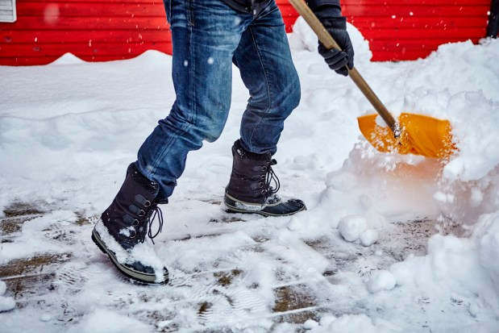
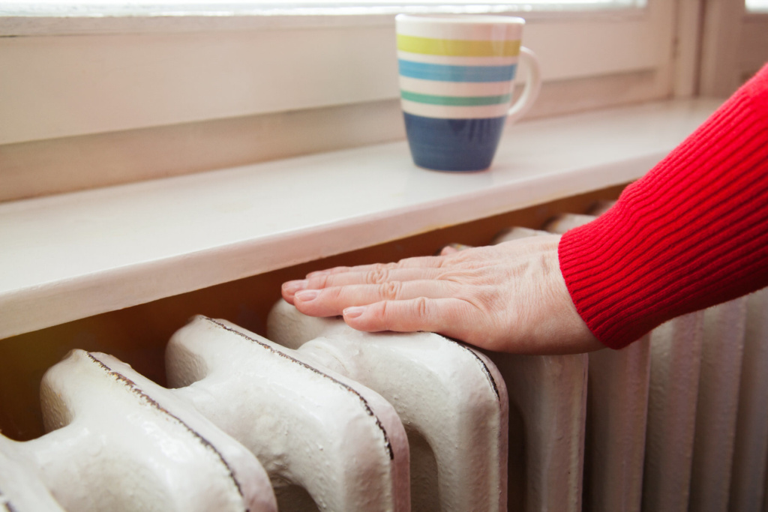
Why we take a proactive approach for winter?
Cold temperatures in winter have an impact on our health, including increased risk of heart attack, stroke, flu, falls, and hypothermia.
Winter weather also affects our wellbeing. As well as things like snow and ice possibly causing disruption to access to services, our mental health may also be affected, and some people will go out less during winter and feel more isolated. This can impact the food we eat and the physical activity we do.
There may be additional risks of carbon monoxide poisoning if our boilers, cooking, or heating appliances are poorly maintained or poorly ventilated.

Slide 4
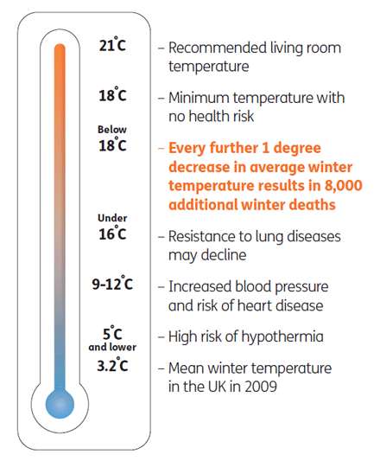
Winter Mortality
Excess winter mortality and illnesses are not always caused by hypothermia or extremes of cold
They are caused or made worse during normal winter temperatures
Normal winter temperatures occur when the average outdoor temperature drops below 5-8°C

Slide 5
Public Health and Winter priorities - 23/24
To reduce winter mortality and morbidity by implementing evidence-based interventions (from the UKHSA Adverse Weather Plan 2023) to protect vulnerable people from the adverse effects of cold weather and build resilience by:
Preventing and managing winter related diseases, infections and ill health in Leeds
Supporting people living with frailty to reduce vulnerability to poor health during the winter period
Mitigating the health impacts of cold and cost of living
https://www.gov.uk/government/publications/adverse-weather-and-health-plan

Slide 6
Key Public Health winter messages
Get your winter vaccines
2. Check your medicines
3. Keep your house warm
4. Seek help if struggling with fuel bills or energy efficiency

Slide 7
Key Public Health winter messages
5. Keep active and seek support if worried about a fall
6. Have hot food, drinks and snacks
7. Ask for help

Slide 8
Key Public Health winter messages
8. Connect to the local community
9. Mental health support
10. Be prepared!

Slide 9
Winter vaccines - 'Get winter strong'
What are the benefits of winter vaccinations?
Vaccines are our best protection against Flu and Covid
Having your winter vaccine will reduce your risk of serious illness
Winter vaccines have kept tens of thousands of people out of hospital and save lives
As well as protecting you and the people around you, vaccinations also protect the NHS over winter by reducing the number of people that are likely to get seriously ill from catching a virus and needing to go to hospital
Links to further information on Flu and Covid-19 vaccines are included at the end of the presentation – these include eligibility criteria, how to access vaccinations as well as information on Pneumococcal and Shingles vaccinations

Slide 10
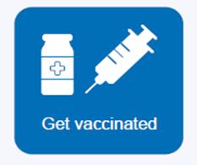
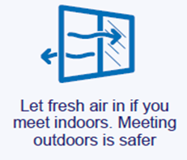
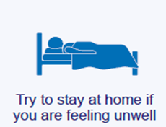
Safe behaviours & actions
Individuals can still reduce the risk of catching and passing on respiratory illnesses:
Getting vaccinated
Ventilation - letting fresh air in
Trying to stay at home if you are unwell
Washing your hands and following advice to ‘Catch it, Bin it, Kill it’ - https://www.nhs.uk/live-well/best-way-to-wash-your-hands/

Slide 11
What support is available in Leeds for our vulnerable service users this winter?

Slide 12
Fall prevention
Active Leeds offers a range of activities to support people to self-manage their health conditions and build fitness, strength and balance
Home Plus Leeds – can also support with a comprehensive home assessment to identify client needs and make recommendations
Find out more information on their website: https://active.leeds.gov.uk/active-leeds-for-health/strength-and-balance-programme-(falls-prevention)
Or call: 0113 378 3680
Email: health.programmes@leeds.gov.uk
Find out more information on their website: https://care-repair-leeds.org.uk/home-plus-2/
Or call: 0113 2406009
Email: enquiries@care-repair-leeds.org.uk

Slide 13
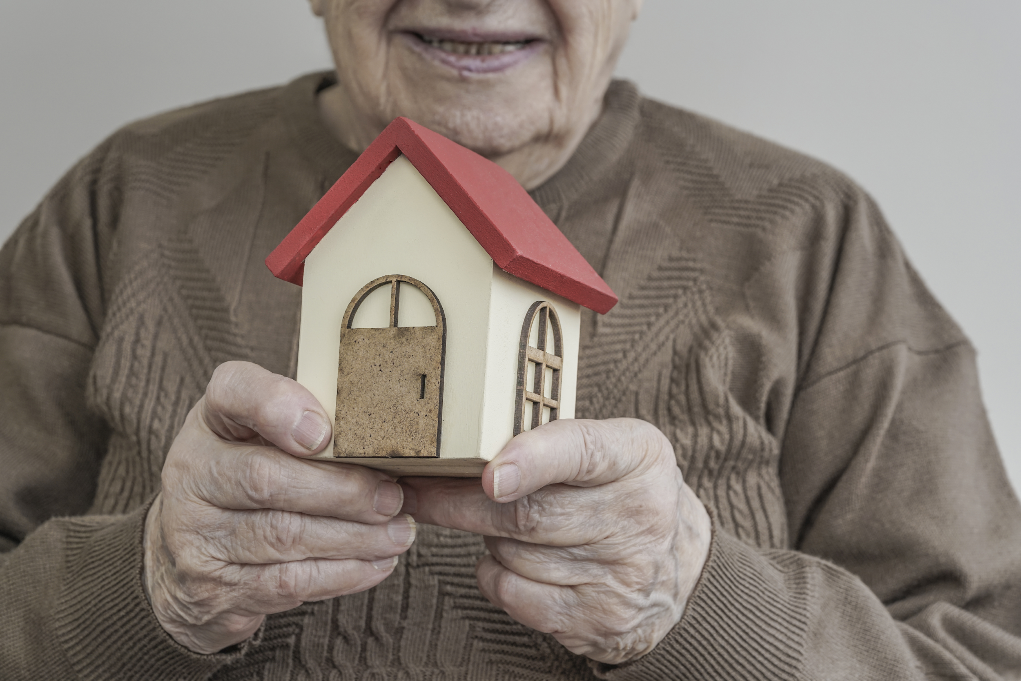
Commissioned since 2018 by:
Improving health at home: Targeted support to enable people to live safely and independently in their own home
A holistic assessment of client needs, facilitating minor works or minor warmth measures, providing advice and assistance, including equipment.
Aims to ensure equitable access for at risk groups and areas of high need e.g. families with children under 5, people with cold related long term health conditions, those at risk of falling, people on low incomes and those who may be isolated.
Delivered by:

Slide 14
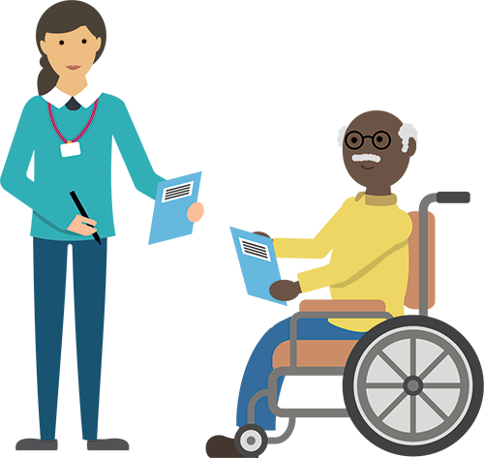
Safety in the home
LCC Adult Social Care can help vulnerable individuals that need support or adaptations in their home to keep safe. This can include a personal alarm, sensors in a chair or bed, falls alarm or additional rails to help getting up and down the stairs, or on and off the toilet.
Find out more information on: https://www.leeds.gov.uk/adult-social-care
Or call: 0113 222 4401
Email: leedsadults@leeds.gov.uk

Slide 15
Mental health and social isolation
Mindwell is the mental health website for adults and provides information about support and services available in Leeds such as mental health services directory and self-help information
Find out more information on their website : www.mindwell-leeds.org.uk
Neighbourhood Networks are community-based organisations that enable older people to live independently by providing services that reduce social isolation, providing opportunities for volunteering and act as a "gateway” to health & wellbeing advice
Find out more information on their website : https://www.leedsdirectory.org/directory/neighbourhood-networks

Slide 16
Access to food
Leeds Food Aid Network brings together different organisations and initiatives which provide food in the city
Find out more information: https://leedsfoodaidnetwork.co.uk/
Lunch Clubs support older people in their communities, providing meals and, in some cases, additional wellbeing and social activities, for their members
Find out more information: https://www.leedscf.org.uk/lunch-clubs-2023/

Slide 17
Financial wellbeing
Together Leeds website provides information and support for people affected by the cost of living
Find out more information: https://www.leeds.gov.uk/campaign/cost-of-living
This includes information on:
Welcome Spaces where people can gather for free to enjoy a hot drink and some company in libraries, community centres, community hubs offered as heated, friendly and safe spaces
Find out more information: https://www.leeds.gov.uk/campaign/welcome-spaces
Money Information Centre website provides access to free, confidential and impartial help and advice on a range of money related matters such as debt, money, energy and utilities
Find out more information: https://www.leeds.gov.uk/leedsmic
Leeds Winter Coat Appeal collects and redistributes great quality, second-hand winter coats to people across Leeds for free
Find out more information: https://www.zerowasteleeds.org.uk/projects/leeds-winter-coat-appeal/

Slide 18
What can we do now to support our service users this winter?

Slide 19
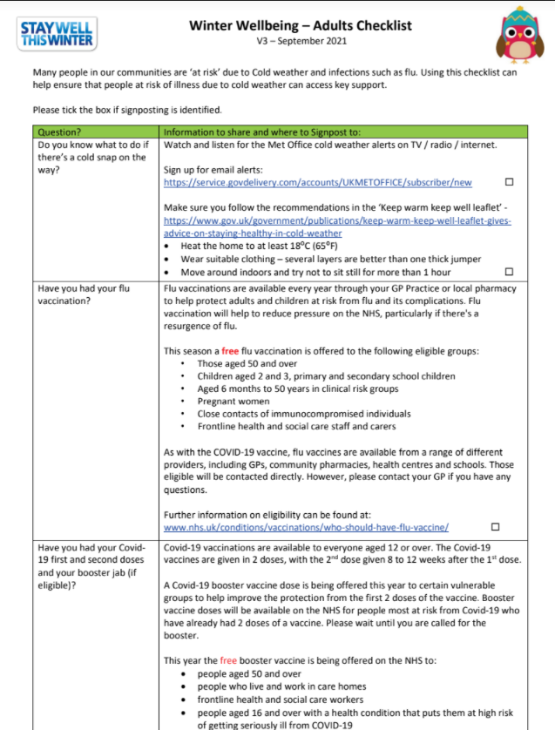
Use the PH winter wellbeing checklist
Checklist to help recap most of what we covered in today's session
Can be used when making wellbeing calls with service users
Can help ensure that people ‘at risk’ of illness due to Cold Weather are prepared for winter and can access support if needed
Available on the Public Health Resource Centre online: https://www.leeds.gov.uk/phrc/public-health-training/winter-wellbeing-checklists

Slide 20
Sign up to MET Office alerts
By knowing there is a cold snap on the way, we can get the essentials ready both for ourselves, in our own homes or for others who may struggle.
The MET office can keep us up to date on the TV, radio, and internet. You can also register to receive email alerts from the MET office by visiting www.metoffice.gov.uk/

Slide 21
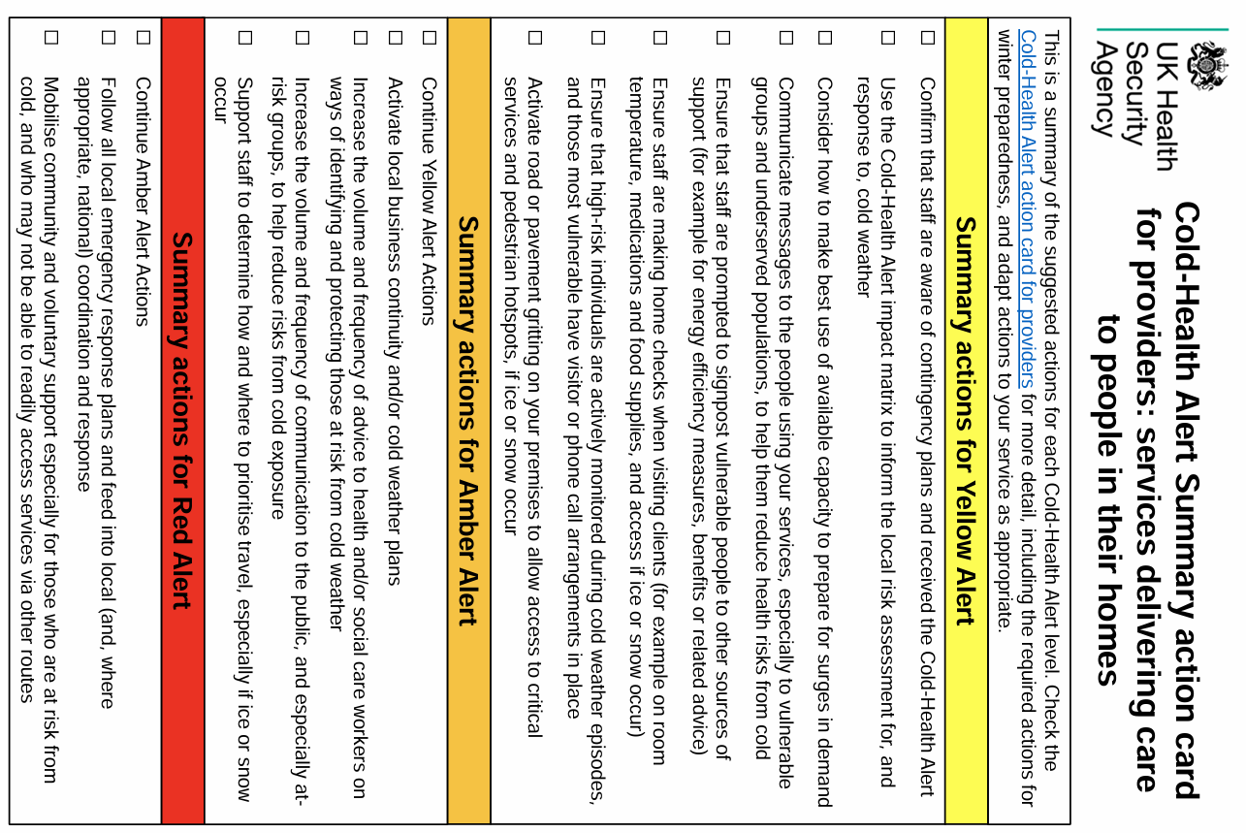
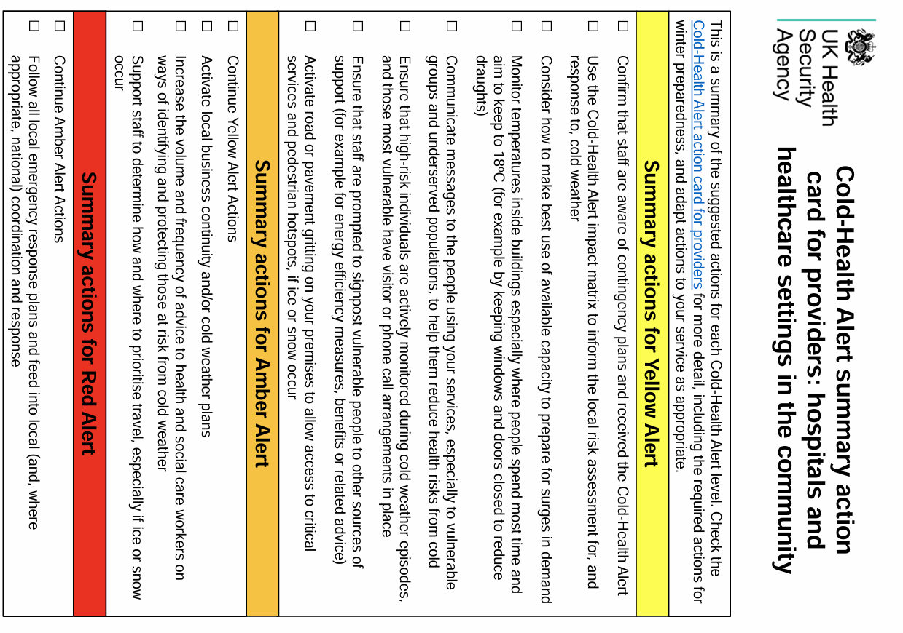
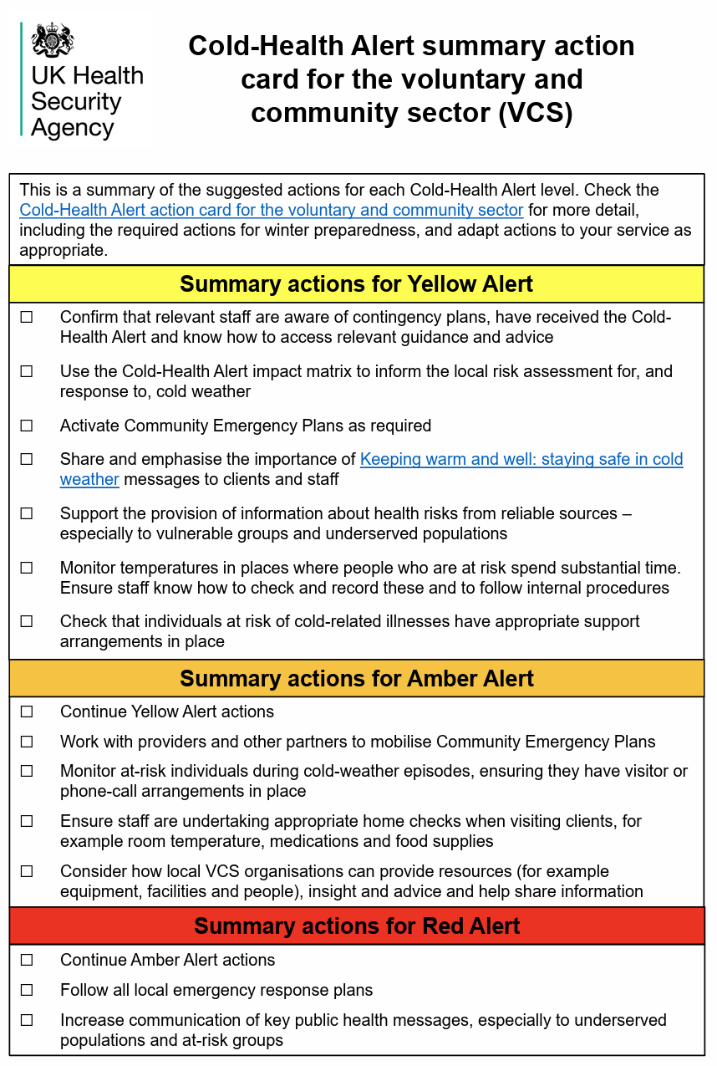
Follow the UKHSA action cards to ensure you are cold-weather prepared
https://www.gov.uk/government/publications/cold-weather-plan-action-cards-for-cold-weather-alert-service

Slide 22
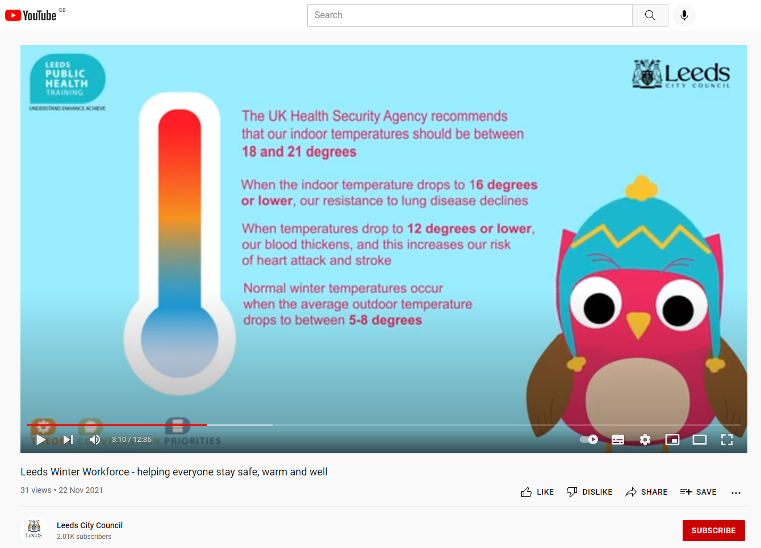
Watch & share the Winter Friends animation
Share the 15-minute animation with colleagues to disseminate key winter messages
Help to familiarise with the ten evidence based, high impact interventions to support
Includes information on keeping homes warm, physical activity, hot food and drink and social connectedness

Slide 23
Sign up to the Winter Friends scheme
Sign up and become a winter friend
Access winter resources to help you and those around you
Find out about winter support services to signpost to
Find out more information: https://winterfriends.org/become-a-winter-friend/

Slide 24
Resources and signposting
Visit the Public Health Resource Centre for resources
Find out more information: https://www.leeds.gov.uk/phrc
Leeds Directory can help people find local support:
Find out more information: https://www.leedsdirectory.org/
Or call: 0113 378 4610 (9am – 5pm, Monday to Friday)
Email: leedsdirectory@leeds.gov.uk
More information about vaccinations:
Flu vaccine Flu vaccine - NHS (www.nhs.uk)​
Covid-19 vaccine Getting a COVID-19 vaccine - NHS (www.nhs.uk)​
Pneumococcal vaccine Pneumococcal vaccine - NHS (www.nhs.uk)​
Shingles vaccine Shingles vaccine - NHS (www.nhs.uk)​
Future NHS FutureNHS Collaboration Platform - FutureNHS Collaboration Platform​
Covid-19 and Flu vaccine information pack AW2334 COVID-19 and Flu information pack​

Slide 25
Any questions?

