Slide 1
Home Upgrade Grant (HUG)
Available to owner occupiers and private tenants across Leeds (and in Wakefield and Calderdale) without gas central heating.
The scheme can provide energy efficiency, low carbon heating and renewable energy improvements.
The scheme is free to owner occupiers. Private landlords pay a third of the total costs.
Property should be Energy Performance Certificate D and below (use this link to check - Find an energy certificate – GOV.UK (www.gov.uk) alternatively the scheme will check)
The household should have a combined income of <£31,000 or live in an Index of Multiple Deprivation Area within Income Deciles 1-3, no income assessment required (we can check this).

Slide 2
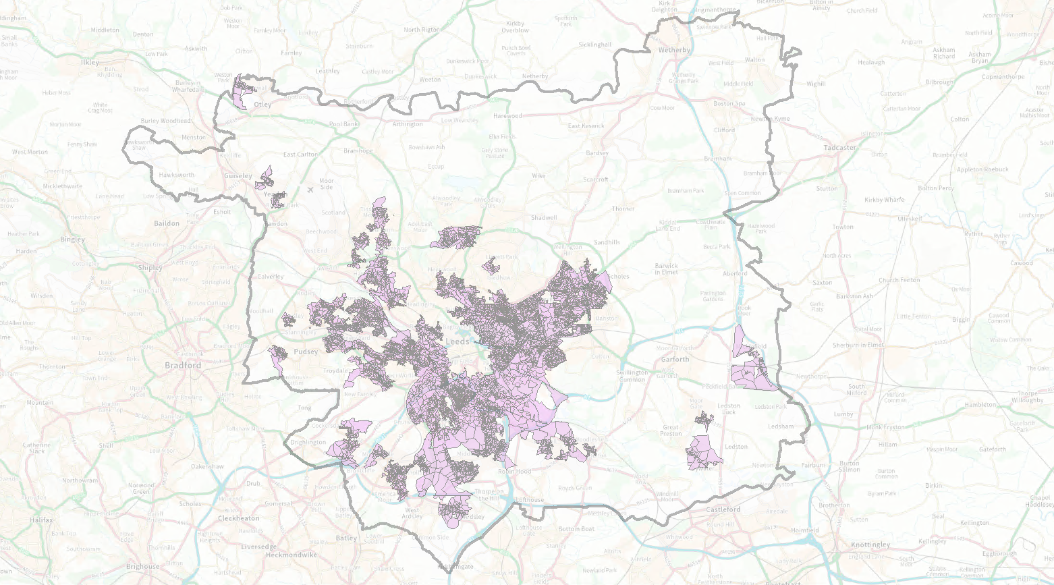
IMD Areas – Income Deciles 1-3

Slide 3
Scheme Process
Your eligibility for the scheme will be confirmed.
A retrofit survey will be undertaken to understand the improvements needed for your home.
Technical surveys will be undertaken for the improvements.
The improvements that can be provided for your home will be confirmed by the council and agreed with you.
The agreed improvements will be installed

Slide 4
HUG – Application
If you think you may be eligible contact Everwarm direct on:
Everwarm's website: Leeds City Council Home Energy (everwarmgroup.com)
Email: enquiries@everwarmgroup.com
Tel: 0800 197 7755

