Slide 1
West Yorkshire Integrated Volunteering Strategy
The West Yorkshire Integrated Volunteering Approaches Group
Notes:
Presenter – intro self and purpose of session.
To introduce our draft WY Volunteering strategy, to give a wide range of organisations who involve volunteers, and volunteers themselves in finalising what our priorities are at a WY level for volunteering.
Our ambition is to strengthen our work around volunteering across the WY health and care system through collaboration, more joined up working and learning and growing together.

Slide 2
Context
In West Yorkshire, we believe volunteering contributes to our ambitions to:
create opportunities to become an active citizen, gain experience and potentially move into work
strengthen system resilience
improve patient experience and health and well-being outcomes
In short, we want West Yorkshire to be a positive and rewarding place to volunteer.
The West Yorkshire Integrated Volunteering Approaches Group developed a set of volunteer principles which have been adopted by our Integrated Care Board (ICB). Our ambition is to build on these and to work together to strengthen the role of volunteering across health and care by:
increasing access and inclusion (including recruitment, support and retention of a diverse range of volunteers)
enabling volunteer movement across organisations
agreeing shared and transferable training
testing new approaches in practice in different health and care settings.
In order to progress towards our ambition, this draft strategy has been developed which aims to identify a few key areas where we believe collaboration at a West Yorkshire level is valuable.
Notes:
To make this happen, we established the West Yorkshire Integrated Volunteering Approaches Group in 2022. This group is made up of volunteering Managers and leaders from Hospital Trusts, Voluntary, community and social enterprise sector (VCSE), Hospices, and Yorkshire Ambulance Service. As a group we have developed a set of volunteer principles which have been adopted by our Integrated Care Board (ICB) and aligned with Humber and North Yorkshire ICB and South Yorkshire ICB.
An ICB or Integrated Care Board is a local partnership that brings health and care organisations together to develop shared plans and joined-up services. They are formed by NHS organisations and upper-tier local councils in that area and also include the voluntary sector, social care providers and other partners with a role in improving local health and wellbeing, with a focus on prevention, better outcomes and reducing health inequalities.
When referring to volunteering across health and care, we are working with the definition that was used in the NHS Volunteering Taskforce consultation:
“Health and care volunteers form an essential part of the community of support that ensures the best experience for people in need of health or social care support. They provide their time and talents, freely and unpaid, for people beyond their close family.
Health and care volunteers are organised by the NHS, public and voluntary sector partners and community groups to deliver individual or collective actions. They have clearly defined roles that often include some degree of selection, training and supervision and are deployed where their role and contribution are valued and respected.”
This draft strategy has been developed by the West Yorkshire Integrated Volunteering Approaches Group (IVAG) and aims to identify a few key areas where we believe collaboration at a WY level makes sense. But we want to hear what you have to say and whether you agree with these priority areas.
Once we have spoken to a range of stakeholders across the system, and agreed a final strategy, we will develop a more detailed plan setting out how we will take this work forwards. We will review this strategy regularly and share updates on developments and opportunities to participate.
We recognise the size, type and capacity of organisations in our system working with volunteers is diverse. We also recognise that each of our places and sectors have different approaches to volunteering and work with volunteers in different ways. This will be reflected in all we do.

Slide 3
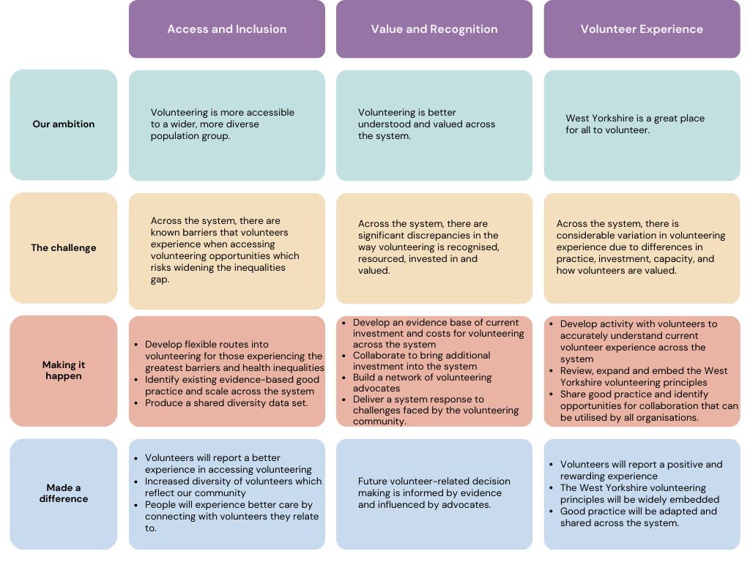
Notes:
Our strategy
On one page. Focused and simple.
We have taken a focused approach on what we believe is best done on a WY footprint. We will always try to align our work with place-based priorities and approaches and will consider current context (i.e., financial, capacity etc.).
We will gather evidence and demonstrate impact.
Underpinning this work will be a robust action plan setting out key activities and actions, and a supporting communication plan.
Once the strategy is finalised and agreed by The People Board, we will share it widely and make it available online on our ICB website and at place.
The strategy will be owned by the IVAG and the group will work closely with The West Yorkshire ICB People Board to embed the strategy across our health and care system.

Slide 4
Getting feedback on the draft strategy
(organisations and stakeholder groups)
A range of stakeholder groups are being held to gain feedback and comments on the proposed strategy. These groups cover all sectors and geographies, and of course, volunteers themselves.
We are asking stakeholders to consider these questions:
Do you identify with the priorities outlined within the strategy?
Which part of the strategy is most important to you/your organisation?
Would you sign up to the strategy?
Do you have any examples of good volunteering practice you can share?
What change would you like to see as a result of the strategy being implemented?
Do you consent to being contacted further regarding the strategy?
The feedback form can be accessed here or by scanning the QR code.
Notes:
A range of engagement sessions will be held across West Yorkshire with various stakeholders and volunteers themselves. We aim to conclude the engagement by the end of July.
A feedback form has been provided using Microsoft Forms to ensure we clearly record any comments/proposed changes, and the link is included within the slide. Please note there are separate feedback forms for stakeholders and volunteers.
Ensure names, organisations and email addresses are captured for each session (if consent is agreed). Plus promote the WY Volunteer Principles and encourage organisations to sign up.
We have designed the strategy to be easy to understand and accessible for everyone. Please let us know if we can do anything to make it more accessible/easy to read.

Slide 5
Getting feedback on the draft strategy
(for use with volunteers)
We are seeking feedback and comments on the proposed strategy from a range of stakeholders. We are keen to ensure we listen to the views of volunteers themselves as part of this process.​
​
We are asking volunteers to consider these questions:
Are the priorities outlined within the strategy important to you as a volunteer?
Which part of the strategy is most important to you/your organisation?
Would you be happy for your organisation to sign up to this strategy?
Does your organisation do anything really well that other organisations with volunteers could learn from?
What change would you like to see as a result of the strategy being implemented?
Do you consent to being contacted further regarding the strategy?
The feedback form can be accessed here or by scanning the QR code.
Notes:
A range of engagement sessions will be held across West Yorkshire with various stakeholders and volunteers themselves. We aim to conclude the engagement by the end of July.
A feedback form has been provided using Microsoft Forms to ensure we clearly record any comments/proposed changes, and the link is included within the slide. Please note there are separate feedback forms for stakeholders and volunteers.
Ensure names, organisations and email addresses are captured for each session (if consent is agreed). Plus promote the WY Volunteer Principles whilst engaging with volunteers – encourage volunteers to encourage organisations to sign up.
We have designed the strategy to be easy to understand and accessible for everyone. Please let us know if we can do anything to make it more accessible/easy to read.

